Slide 1

Advanced Product Quality Planning (APQP) and Production Part Approval Process (PPAP)
Supplier Overview Training
Document CQD-116; Rev 1; 4/14/18

Slide 2
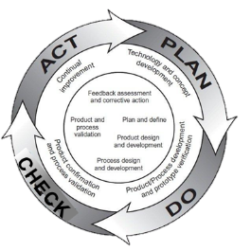
What is APQP?
Advanced Product Quality Planning Cycle
Advanced Product Quality Planning method to assure that a product satisfies the customer (both internal and external)
The goal of APQP is to:
  Plan before acting
  Anticipate and prevent issues
  Validate before moving forward
  Facilitate communication
Each Advanced Product Quality Plan is unique and is a living document
Particular emphasis should be placed on identifying critical path activities and ensuring those are fully resourced
Notes:
On this slide we have some APQP definitions taken from the AIAG manual Automotive Industry Action Group. If we read through the first two definitions we will discover 2 essential ideas:
The customer satisfaction is our (and any businesses‘) main goal;
Communication between the team is the way of getting there.
APQP is the perfect way of making that happening.
Every project is unique, so every Advanced Product Quality Plan will be different, depending on the customers’ expectations, needs, risk and the quality level, but we must use APQP so we can identify the high risk and long lead time requirements (particularly when the Supply Chain, CTQs or Special Characteristics are involved)

Slide 3
APQP Background
Automotive industry challenges:
  Innovation, more complex product
  Reduce NPD times
  Complicated Supply chain
  Increasing customer and quality requirements
Solution:
  Ford, GM, Chrysler APQP Task Force jointly developed in the late 80’s to standardize their respective supplier quality systems.
Continuous Improvement:
  Many industries outside the Automotive industry have embraced the AIAG APQP process to achieve similar benefits
Notes:
APQP comes from the automotive industry and they need it because of their products complexity and of their complicated supply chain.
As we all know, timing and quality are everything in any business, not only for the automotive.
In the 80’s Ford, GM and Chrysler joined forces and for 5 years they’ve developed their own guidance and formats on assuring suppliers APQP compliance.
The Japanese industry had a huge success in this and they’ve developed the Automotive Industry Action Group (AIAG) manuals on APQP and not only, where common methodology, procedures and technics can be studies in more depth.
{
BLUE BOX – PROLaunch is APQP compliant but it needs to be better executed
PQP originates from the automotive industry due to different and several innovations, developments and improvements more complex products, different models were made which resulted in a more complicated supply chain and triggered increased customer and quality requirements.
For example: during the 70-80 many automotive plants faced serious quality problems at serial production start up. E.g…….1500
Advanced product quality planning was developed in the late 1980s by a commission of experts gathered from the 'Big Three' US automobile manufacturers: Ford, GM and Chrysler. In the past, they each had their own guidelines and formats for ensuring supplier APQP compliance. Differences between these guidelines and formats resulted in additional demands on supplier resources. To improve upon this situation, the commission invested five years to analyze the then-current automotive development and production status in the US, Europe and especially in Japan since that time, the success of the Japanese automotive companies was starting to be remarkable in the US market.
They came up with the Automotive Industry Action Group, also known as AIAG manual on APQP which describes common methodology, procedures and techniques on APQP . It is used today by these three companies. Typically they require Tier 1 suppliers to follow APQP according to this manual.
BTW I also used this manual to put together this training package.
AIAI, is a not-for profit org. 1982 AIAG was formed as a committee within APICS APICS The Association for Operations Management,
(founded in 1957 as the American Production and Inventory Control Society)
Since 1957, supply chain and operations management professionals like you have relied on APICS as the global leader and premier source of the body of knowledge in the industry. Our focus includes superior training, internationally-recognized certifications, and comprehensive educational resources in the areas of production, inventory, materials management, purchasing, logistics, and more.
American Production and Inventory Control Society
AIAI, is a not-for profit org. 1982 AIAG was formed as a committee within APICS APICS The Association for Operations Management,
(founded in 1957 as the American Production and Inventory Control Society)
Since 1957, supply chain and operations management professionals like you have relied on APICS as the global leader and premier source of the body of knowledge in the industry. Our focus includes superior training, internationally-recognized certifications, and comprehensive educational resources in the areas of production, inventory, materials management, purchasing, logistics, and more.
American Production and Inventory Control Society }

Slide 4
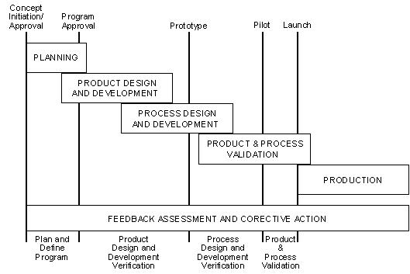
APQP – timing chart and phases - AIAG
The Advanced Product Quality Planning process consists of four phases and five major activities and has some 20+ supporting tools (e.g. DFMEA, PFMEA, CTQ, Special Characteristics, Control Plan, SPC) along with ongoing feedback assessment and corrective action.
Notes:
In this graph we can see the phases and main activities of APQP.
There are 4 phases(bottom) and 5 activities (top) plus over 20 supporting tools for us to use.
You can see the similarity between this and the PROLaunch process and in the next slide we’ll see this better.

Slide 5
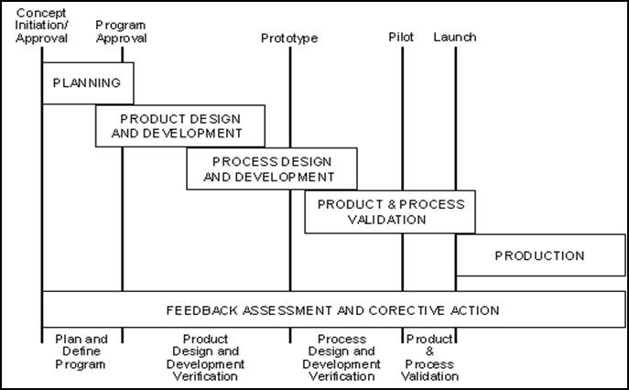
1. Plan and Define Program
INPUTS:
OUTPUTS:
Voice of the Customer
  Market Research
  Historical Warranty and Quality Information
  Team Experience
Business Plan/Marketing Strategy
Product/Process Benchmark Data
Product/Process Assumptions
Product Reliability Studies
Customer Inputs
Design Goals
Reliability & Quality goals
CONC targets
Preliminary Bill of Materials
Preliminary Process Flow Chart
Preliminary list of Special Product and Process Characteristics
Product Assurance Plan
Management Support
Assure that customer needs and expectations are clearly understood.
* The inputs and outputs applicable to the process may vary according to the product process and customer needs and expectations.
Notes:
We will go through the APQP phases and see what the inputs and outputs are for each of them.
This phase’s input are based on the market intelligence (information). It is very important for us to take into account the historical warranty and quality information.
The output will be setting out the design goals, reliability and quality goals, CONC (cost of nonconformance) targets, create preliminary BOMs and process flows, but the most important thing is making sure that the customers need and expectations are understood.

Slide 6
2. Product Design and Development - 1
INPUTS:
OUTPUTS:
Design Goals
Reliability & Quality goals
Preliminary Bill of Materials
Preliminary Process Flow Chart
Preliminary list of Special Product and Process Characteristics
Product Assurance Plan
Design Failure Mode and Effects Analysis (DFMEA)
Design For Manufacturability and Assembly
Design Verification
Design Reviews
Prototype Build – Control plan
Engineering Drawings (Including Math Data)
Engineering Specifications
Material Specifications
Drawing and Specification Changes
Develop design into a near final form.
Prototype and feasibility studies – volumes, schedule, manufacturing.
Cont. next slide
Notes:
Outputs design
This phase is about the elements of the planning process during which design features and characteristics are developed into a near final form. The Product Quality Planning Team should consider all design factors in the planning process even if the design is owned by the customer or shared. The steps include prototype build to verify that the product or service meets the objectives of the Voice of the Customer. A feasible design must permit meeting production volumes and schedules, and be consistent with the ability to meet engineering requirements, along with quality, reliability, investment cost, weight, unit cost and timing objectives. Although feasibility studies and control plans are primarily based on engineering drawings and specification requirements, valuable information can be derived from the analytical tools described in this section to further define and prioritize the characteristics that may need special product and process controls. In this section, the Product Quality Planning Process is designed to assure a comprehensive and critical review of engineering requirements and other related technical information. At this stage of the process, a preliminary feasibility analysis will be made to assess the potential problems that could occur during manufacturing.
DESIGN FAILURE MODE AND EFFECTS ANALYSIS (DFMEA)
The DFMEA is a disciplined analytical technique that assesses the probability of failure as well as the effect of such failure. A form of DFMEA is a Systems Failure Mode and Effects Analysis (SFMEA). A DFMEA is a living document continually updated as customer needs and expectations require. Preparing the DFMEA provides the team an opportunity to review the previously selected product and process characteristics and make necessary additions, changes, and deletions. The Chrysler, Ford and General Motors Potential Failure Mode and Effects Analysis reference manual should be used for the acceptable method of preparing a DFMEA. The Design FMEA Checklist in Appendix A-1 should also be reviewed to assure that the appropriate design characteristics have been considered.
2.2 DESIGN FOR MANUFACTURABILITY AND ASSEMBLY
Design for Manufacturability and Assembly is a Simultaneous Engineering process designed to optimize the relationship between design function, manufacturability, and ease of assembly. The scope of customer needs and expectations defined in Section 1.0 will determine the extent of the supplier’s
Product Quality Planning Team involvement in this activity. This manual does not include or refer to a formal method of preparing a Design for manufacturability and Assembly Plan. At a minimum, the items listed here should be considered by the Product Quality Planning Team:
• Design, concept, function, and sensitivity to manufacturing variation
• Manufacturing and/or assembly process
• Dimensional tolerances
• Performance requirements
• Number of components
• Process adjustments
• Material Handling
The Product Quality Planning Team’s knowledge, experience, the product/process, government regulations, and service requirements may require other factors to be considered.
DESIGN VERIFICATION
Design Verification verifies that the product design meets the customer requirements derived from the activities described in Section 1.0.
2.4 DESIGN REVIEWS
Design Reviews are regularly scheduled meetings led by the supplier’s design engineering activity and must include other affected areas. The Design Review is an effective method to prevent problems and misunderstandings; it also provides a mechanism to monitor progress and report to management.
Design Reviews are a series of verification activities that are more than an engineering inspection. At a minimum Design Reviews should include evaluation of:
• Design/Functional requirement(s) considerations
• Formal reliability and confidence goals
• Component/subsystem/system duty cycles
• Computer simulation and bench test results
• DFMEA(s)
• Review of the Design For Manufacturability and Assembly effort
• Design Of Experiments (DOE) and assembly build variation results (Refer to Appendix B.)
• Test failures
• Design Verification progress
A major function of Design Reviews is the tracking of design verification progress. The supplier
should track design verification progress through the use of a plan and report format, referred to as
Design Verification Plan and Report (DVP&R) by Chrysler and Ford. The plan and report is a formal
method to assure:
• Design verification
• Product and process validation of components and assemblies through the application of a
comprehensive test plan and report.
The Product Quality Planning Team is not limited to the items listed. The team should consider and use as appropriate, the analytical techniques listed in Appendix B.
2.5 PROTOTYPE BUILD - CONTROL PLAN
Prototype Control Plans are a description of the dimensional measurements and material and functional tests that will occur during prototype build. The Product Quality Planning Team should ensure that a prototype control plan is prepared. Control plan methodology is described in Section 6. A Control Plan Checklist is provided in both Appendix A-8 and Section 6 to assist in the preparation of the prototype control plan. The manufacture of prototype parts provides an excellent opportunity for the team and the customer to evaluate how well the product or service meets Voice of the Customer objectives. All prototypes that are the Product Quality Planning Team’s responsibility should be reviewed to:
• Assure that the product or service meets specification and report data as required.
• Ensure that particular attention has been given to special product and process characteristics.
• Use data and experience to establish preliminary process parameters and packaging requirements.
• Communicate any concerns, deviations, and/or cost impact to the customer.
2.6 ENGINEERING DRAWINGS (Including Math Data)
Customer designs do not preclude the planning team’s responsibility to review engineering drawings in the following manner. Engineering drawings may include special (governmental regulatory and safety) characteristics that must be shown on the control plan. When customer engineering drawings are
nonexistent, the controlling drawings should be reviewed by the planning team to determine which characteristics affect fit, function, durability and/or governmental regulatory safety requirements. Drawings should be reviewed to determine if there is sufficient information for a dimensional layout of
the individual parts. Control or datum surfaces/locators should be clearly identified so that appropriate functional gages and equipment can be designed for ongoing controls. Dimensions should be evaluated to assure feasibility and compatibility with industry manufacturing and measuring standards. If appropriate, the team should assure that math data is compatible with the customer’s system for effective two-way communications.
2.7 ENGINEERING SPECIFICATIONS
A detailed review and understanding of the controlling specifications will help the Product Quality Planning Team to identify the functional, durability and appearance requirements of the subject component or assembly. Sample size, frequency, and acceptance criteria of these parameters are generally defined in the in-process test section of the Engineering Specification. Otherwise, the sample size and frequency are to be determined by the supplier and listed in the control plan. In either case, the supplier should determine which characteristics affect or control the results that fulfill meeting functional, durability, and appearance requirements.
2.8 MATERIAL SPECIFICATIONS
In addition to drawings and performance specifications, material specifications should be reviewed for Special Characteristics relating to physical properties, performance, environmental, handling, and storage requirements. These characteristics should also be included in the control plan.
2.9 DRAWING AND SPECIFICATION CHANGES
Where drawing and specification changes are required, the team must ensure that the changes are promptly communicated and properly documented to all affected areas.

Slide 7
2. Product Design and Development - 2
INPUTS:
OUTPUTS:
Design Goals
Reliability & Quality goals
Preliminary Bill of Materials
Preliminary Process Flow Chart
Preliminary list of Special Product and Process Characteristics
Product Assurance Plan
New Equipment, Tooling and Facilities Requirements
Special Product and Process Characteristics
Gages/Testing Equipment Requirements
Team Feasibility Commitment
Management Support
Develop design into a near final form.
Prototype and feasibility studies – volumes, schedule, manufacturing.
Notes:
Outputs APQP
NEW EQUIPMENT, TOOLING AND FACILITIES REQUIREMENTS
The DFMEA, Product Assurance Plan and/or Design Reviews may identify new equipment and facilities requirements. The Product Quality Planning Team should address these requirements by adding the items to the Timing Chart. The team should ensure that the new equipment and tooling is capable and delivered on time. Facilities progress should be monitored to assure completion to surpass planned production tryout. Refer to the New Equipment, Tooling and Test Equipment Checklist in Appendix A-3.
2.11 SPECIAL PRODUCT AND PROCESS CHARACTERISTICS
In the stage of quality planning described in Section 1.0, the team identified preliminary special product and process characteristics resulting from understanding the Voice of the Customer. The Product Quality Planning Team should build on this listing and reach consensus during the review and
development of design features through the evaluation of the technical information. Appendix C contains a table describing the symbols Chrysler, Ford and General Motors use to denote Special Characteristics. The consensus is to be documented on the appropriate Control Plan. The Control Plan Special Characteristics and Data Point Coordinates forms referenced in Section 6, Supplements K and L, are recommended methods to document and update Special Characteristics, as required, to support the Prototype, Pre-Launch, and Production Control Plans. The supplier can use any form that accomplishes the same documentation requirement. Customers may have unique approval requirements. Refer to Chrysler, Ford, and General Motors Quality System Requirements, Section III for details.
2.12 GAGES/TESTING EQUIPMENT REQUIREMENTS
Gages/testing equipment requirements may also be identified at this time. The Product Quality Planning Team should add these requirements to the Timing Chart. Progress will then be monitored to assure that required timing is met.
2.13 TEAM FEASIBILITY COMMITMENT AND MANAGEMENT SUPPORT
The Product Quality Planning Team must assess the feasibility of the proposed design at this time. Customer design ownership does not preclude the supplier’s obligation to assess design feasibility. The team must be satisfied that the proposed design can be manufactured, assembled, tested, packaged, and delivered in sufficient quantity, at an acceptable cost to the customer on schedule. The Design Information Checklist in Appendix A-2 allows the team to review its efforts in this section and make an evaluation of its effectiveness. This checklist will also serve as a basis for the open issues discussed
in the Team Feasibility Commitment, Appendix E. The team consensus that the proposed design is feasible should be documented along with all open issues that require resolution and presented to management for their support. The Team Feasibility Commitment form shown in Appendix E is an example of the type of written record recommended.

Slide 8
3. Process Design and Development
INPUTS:
OUTPUTS:
Design Failure Mode and Effects Analysis (DFMEA)
Design For Manufacturability and Assembly
Design Verification
Design Reviews
Prototype Build – Control Plan
Engineering Drawings (Including Math Data)
Engineering Specifications
Material Specifications
Drawing and Specification Changes
New Equipment, Tooling and Facilities Requirements
Special Product and Process Characteristics
Gages/Testing Equipment Requirements
Team Feasibility Commitment
Management Support
Packaging Standards
Product/Process Quality System Review
Process Flow Chart
Floor Plan Layout
Characteristics Matrix
Process Failure Mode and Effects Analysis (PFMEA)
Pre-Launch Control Plan
Process Instructions
Measurement Systems Analysis Plan
Preliminary Process Capability Study Plan
Packaging Specifications
Management Support
Develop a manufacturing system and its related control plans to achieve quality products.
Notes:
This phase discusses the major features of developing a manufacturing system and its related control plans to achieve quality products. The tasks to be accomplished at this step of the product quality planning process depend upon the successful completion of the prior stages contained in the first two sections. This next step is designed to ensure the comprehensive development of an effective manufacturing system. The manufacturing system must assure that customer requirements, needs and expectations are met.
3.1 PACKAGING STANDARDS
The customer will usually have packaging standards that should be incorporated into any packaging specifications for the product. If none are provided, the packaging design should ensure product integrity at point of use.
3.2 PRODUCT/PROCESS QUALITY SYSTEM REVIEW
The Product Quality Planning Team should review the manufacturing location’s Quality System Manual. Any additional controls and/or procedural changes required to produce the product should be updated in the Quality System Manual and should also be included in the manufacturing control plan.
This is an opportunity for the Product Quality Planning Team to improve the existing quality system based on customer input, team expertise, and previous experience. The Product/Process Quality Checklist provided in Appendix A-4 can be used by the Product Quality Planning Team to assist in its evaluation.
3.3 PROCESS FLOW CHART
The process flow chart is a schematic representation of the current or proposed process flow. It can be used to analyze sources of variations of machines, materials, methods, and manpower from the beginning to end of a manufacturing or assembly process. It is used to emphasize the impact of sources of variation on the process. The flow chart helps to analyze the total process rather than individual steps in the process. The flow chart assists the Product Quality Planning Team to focus on the process when conducting the PFMEA and designing the Control Plan. The Process Flow Chart Checklist in Appendix A-6 can be used by the Product Quality Planning Team to assist in its evaluation.
3.4 FLOOR PLAN LAYOUT
The floor plan should be developed and reviewed to determine the acceptability of inspection points, control chart location, applicability of visual aids, interim repair stations, and storage areas to contain defective material. All material flow should be keyed to the process flow chart and control plan. The
Floor Plan Checklist in Appendix A-5 can be used by the Product Quality Planning Team to assist in its evaluation.
3.5 CHARACTERISTICS MATRIX
A characteristics matrix is a recommended analytical technique for displaying the relationship between process parameters and manufacturing stations. See Analytical Techniques in Appendix B for further detail.
PROCESS FAILURE MODE AND EFFECTS ANALYSIS
A PFMEA should be conducted during product quality planning and before beginning production. It is a disciplined review and analysis of a new/revised process and is conducted to anticipate, resolve, or monitor potential process problems for a new/revised product program. A PFMEA is a living document and needs to be reviewed and updated as new failure modes are discovered. For further information on the creation and maintenance of PFMEAs refer to Chrysler, Ford and General Motors Potential Failure Mode and Effects Analysis (FMEA) reference manual. The Process FMEA Checklist in Appendix A-7 can be used by the Product Quality Planning Team to assist in its evaluation.
3.7 PRE-LAUNCH CONTROL PLAN
Pre-launch Control Plans are a description of the dimensional measurements and material and functional tests that will occur after prototype and before full production. The pre-launch control plan should include additional product/process controls to be implemented until the production process is validated. The purpose of the pre-launch control plan is to contain potential nonconformances during or prior to initial production runs. Examples are:
• More frequent inspection
• More in-process and final check points
• Statistical evaluations
• Increased audits
For further information on the creation and maintenance of control plans refer to Section 6. The Control Plan Checklist in Appendix A-8 can be used by the Product Quality Planning Team to assist in its evaluation.
3.8 PROCESS INSTRUCTIONS
The Product Quality Planning Team should ensure that understandable process instructions provide sufficient detail for all operating personnel who have direct responsibility for the operation of the processes. These instructions should be developed from the following sources:
• FMEAs
• Control plan(s)
• Engineering drawings, performance specifications, material specifications, visual standards and
industry standards
• Process flow chart
• Floor plan layout
• Characteristics matrix
Packaging Standards
• Process parameters
• Producer expertise and knowledge of the processes and products
• Handling requirements
• Operators of the Process
The process instructions for standard operating procedures should be posted and should include set-up parameters such as: machine speeds, feeds, cycle times, etc., and should be accessible to the operators and supervisors. Additional information for process instruction preparation can be found in the Chrysler, Ford, and General Motors Quality System Requirements.
3.9 MEASUREMENT SYSTEMS ANALYSIS PLAN
The Product Quality Planning Team should ensure that a plan to accomplish the required measurement systems analysis is developed. This plan should include, at a minimum, the responsibility to ensure gage linearity, accuracy, repeatability, reproducibility, and correlation for duplicate gages. Refer to the
Chrysler, Ford, and General Motors Measurement Systems Analysis Reference Manual.
3.10 PRELIMINARY PROCESS CAPABILITY STUDY PLAN
The Product Quality Planning Team should ensure the development of a preliminary process capability plan. The characteristics identified in the control plan will serve as the basis for the preliminary process capability study plan. Reference the Chrysler, Ford, and General Motors Production Part
Approval Process manual and Chrysler, Ford, and General Motors Fundamental Statistical Process Control Reference Manual for further definition.
3.11 PACKAGING SPECIFICATIONS
The Product Quality Planning Team should ensure that individual product packaging (including interior partitions) is designed and developed. Customer packaging standards or generic packaging requirements should be used when appropriate. In all cases the packaging design must assure that the
product performance and characteristics will remain unchanged during packing, transit, and unpacking. The packaging should have compatibility with all material handling equipment including robots.
3.12 MANAGEMENT SUPPORT
The Product Quality Planning Team is required to schedule the formal review designed to reinforce management commitment at the conclusion of the process design and development phase. The purpose of this review is to inform upper management of program status and gain their commitment to
assist in resolution of any open issues.

Slide 9
4. Product and Process Validation
INPUTS:
OUTPUTS:
Packaging Standards
Product/Process Quality System Review
Process Flow Chart
Floor Plan Layout
Characteristics Matrix
Process Failure Mode and Effects Analysis (PFMEA)
Pre-Launch Control Plan
Process Instructions
Measurement Systems Analysis Plan
Preliminary Process Capability Study Plan
Packaging Specifications
Management Support
Measurement Systems Evaluation
Significant Production Run
Preliminary Process Capability Study
Production Part Approval
Production Validation Testing
Packaging Evaluation
Production Control Plan
Quality Planning Sign-Off - formal
Management Support
Validate manufacturing process through production trial run.
Validate that the control plan and process flow chart are effective and that the product meets customer expectation.
Notes:
This section discusses the major features of validating the manufacturing process through an evaluation of a production trial run. During a production trial run, the Product Quality Planning Team should validate that the control plan and process flow chart are being followed and the products meet customer requirements. Additional concerns should be identified for investigation and resolution prior to regular production runs.
PRODUCTION TRIAL RUN
Significant production run must be conducted using production tooling, equipment, environment (including production operators), facility, and cycle time. The validation of the effectiveness of the manufacturing process begins with the production trial run. The minimum quantity for a production trial run is usually set by the customer but can be exceeded by the Product Quality Planning Team. Output of the production trial run (product) is used for:
• Preliminary process capability study
• Measurement systems evaluation
• Final feasibility
• Process review
• Production validation testing
• Production part approval
• Packaging evaluation
• First time capability (FTC)
• Quality planning sign-off
4.2 MEASUREMENT SYSTEMS EVALUATION
The specified measurement devices and methods should be used to check the control plan identified characteristics to engineering specification and be subjected to measurement system evaluation during or prior to the production trial run. Refer to the Chrysler, Ford, and General Motors Measurement
Systems Analysis Reference Manual.
4.3 PRELIMINARY PROCESS CAPABILITY STUDY
The preliminary process capability study should be performed on characteristics identified in the control plan. The study provides an assessment of the readiness of the process for production. Refer to the Chrysler, Ford, and General Motors Production Part Approval Process reference manual and Chrysler, Ford, and General Motors Fundamental Statistical Process Control Reference Manual for details concerning the preliminary process capability study.
4.4 PRODUCTION PART APPROVAL
The intent of production part approval is to validate that products made from production tools and processes meet engineering requirements. Refer to the Chrysler, Ford, and General Motors Production Part Approval Process reference manual.
4.5 PRODUCTION VALIDATION TESTING
Production validation testing refers to engineering tests that validate that products made from production tools and processes meet engineering standards. Refer to the Chrysler, Ford, and General Motors Quality System Requirements for specific requirements.
PACKAGING EVALUATION
All test shipments (where feasible) and test methods must assess the protection of the product from normal transportation damage and adverse environmental factors. Customer-specified packaging does not preclude the Product Quality Planning Team involvement in evaluating the packaging method.
4.7 PRODUCTION CONTROL PLAN
The production control plan is a written description of the systems for controlling parts and processes. The production control plan is a living document and should be updated to reflect the addition/deletion of controls based on experience gained by producing parts. (Approval of the procuring organization(s)
may be required.) The production control plan is a logical extension of the pre-launch control plan. Mass production provides the producer the opportunity to evaluate output, review the control plan and make appropriate changes. Section 6 and Appendix A-8 present Control Plan Methodology and a
checklist to assist the producer in this review. There can be other types of control plans. An example is the Ford Dynamic Control Plan (DCP) described in Appendix B and detailed in Appendix G.
4.8 QUALITY PLANNING SIGN-OFF AND MANAGEMENT SUPPORT
The Product Quality Planning Team should perform a review at the manufacturing location and coordinate a formal sign off. The product quality sign off indicates to management that the appropriate APQP activities have been completed. The sign off occurs prior to first production shipment.
Process Flow charts – exist and followed
• Control Plans. Control plans should exist and be available at all times for all affected operations.
• Process Instructions. Verify that these documents contain all the Special Characteristics specified
in the control plan and that all PFMEA recommendations have been addressed. Compare the
process instructions and process flow chart to the control plan.
• Monitoring and measuring devices - Gage and Test Equipment. Where special gages, fixtures, or test equipment are required per the
control plan, verify gage repeatability and reproducibility (GR&R) and proper usage. (
Demonstration of required capacity.
Management support is necessary prior to the quality planning sign-off. The team should be able to show that all planning requirements are met or concerns documented and schedule a management review. The purpose of this review is to inform upper management of program status and gain their commitment to assist in any open issues. The Product Quality Planning Summary and Sign-Off report shown in Appendix F is an example of the documentation required to support an effective quality planning sign-off.

Slide 10
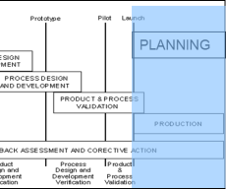
Feedback, Assessment, Corrective actions
INPUTS:
OUTPUTS:
Production Trial Run
Measurement Systems Evaluation
Preliminary Process Capability Study
Production Part Approval
Production Validation Testing
Packaging Evaluation
Production Control Plan
Quality Planning Sign-Off and Management Support
Reduced Variation
Improved Customer Satisfaction
Improved Delivery and Service
Effective use of best practice, lessons learned
Maximum ROI
Minimum Waste
Minimum CONC
Evaluate outputs, effectiveness of the product quality planning efforts.
Notes:
Quality planning does not end with process validation and installation. It is the component manufacturing stage where output can be evaluated when all special and common causes of variation are present. This is also the time to evaluate the effectiveness of the product quality planning effort.
The production control plan is the basis for evaluating product or service at this stage. Variable and attribute data must be evaluated. Appropriate actions as described in the Chrysler, Ford, and General Motors Fundamental Statistical Process Control Reference Manual must be taken. It is the obligation of all suppliers to meet customer requirements on all characteristics. Special Characteristics must meet the indices specified by the customer.
REDUCED VARIATION
Control charts and other statistical techniques should be used as tools to identify process variation. Analysis and corrective actions should be used to reduce variation. Continual improvement requires attention not only to the special causes of variation but understanding common causes and seeking ways to reduce these sources of variation. Proposals should be developed including costs, timing, and anticipated improvement for customer review. Often the reduction or elimination of a common cause results in lower costs. Suppliers should not be reluctant to prepare proposals based on value analysis,
reduction of variation, etc. The decision to implement, negotiate, or progress to the next product design level is the customer’s prerogative. Refer to the Chrysler, Ford, and General Motors Fundamental Statistical Process Control Reference Manual for details on long-term capability, special and common causes of variation.
5.2 CUSTOMER SATISFACTION
Detailed planning activities and demonstrated process capability of a product or service do not always guarantee customer satisfaction. The product or service must perform in the customer environment. The product usage stage requires supplier participation. It is in this stage where the most can be
learned by both the supplier and customer. The effectiveness of the Product Quality Planning efforts can be evaluated in this stage. The supplier and customer must be partners in making the changes necessary to correct deficiencies to achieve customer satisfaction.
5.3 DELIVERY AND SERVICE
The delivery and service stage of quality planning continues the supplier/customer partnership in solving problems and continual improvement. The customer’s replacement parts and service operations always merit the same consideration in quality, cost, and delivery. Failure to correct a problem the first time always damages the supplier’s reputation and customer partnership. It is important that both supplier and customer listen to the Voice of the Customer.
The experience gained in this stage provides the customer and supplier with the necessary knowledge to recommend price reductions achieved by reducing process, inventory, and quality costs and to provide the right component or system for the next product.

Slide 11
Application to Different Mfg. Environments
High Volume
  APQP plans and activities are organized by part number and are very specific to the part
Low Volume
  APQP plans may be specific to part families with activities focused on the parent part
  More limited validation would be done on child parts
  Family part differences should be understood and higher risk differences incorporated into APQP plans
Engineer to Order (ETO)
  APQP plans may use a part family approach for standardized elements
  Consider a manufacturing process focus for non-standard elements
    Create FMEAs and Control Plans for manufacturing processes rather than parts

Slide 12
APQP Summary:
What we do:
How we do it: APQP
What we get:
Design Quality
  DFMEA / PFMEA / DFM/A
Manufacturing Quality
  Control Plans
  Process Flows
  Measurement System Analysis
  Capability Analysis
  Process Validation
  Run at rate
Supplier Qualification & Quality Requirements
Product Qualification
  1st Article Inspection
  PPAP
  Tooling & Gauges
  Testing
Defect Free Launches
Reduced Warranty Claims
Zero Spills
Customer Satisfaction
Robust Products
Greater Supplier Control
Reduced supplier cost
UP
FRONT
DETAILED
QUALITY
PLANNING
Leadership Engagement is Critical
Notes:
You can see some of the APQP elements and tools we must use to make sure we build quality into the product.
FELL is deploying the APQP process through PROLaunch
And the outputs of this deployment and the teams effort are listed: satisfied customers and reduced costs for the company.
{For PropLaunch NPD deployment but you can find the same activities in STP too (even if for STP there are some activities that must be just reviewed and making sure that all conditions in the new location are the same) – again missing quality plan.}

Slide 13
APQP Benefits:
Manufacturing process functions that are clearly planned, validated, documented and communicated that result in:
Robust and reliable designs
Reduced process variation
Enhanced confidence in supplier’s capabilities
Better controlled process changes
Defect free launches
Improved Customer satisfaction
Improved Delivery and Service
Maximum ROI
Minimum Waste
Minimum Cost of Non-conformance
CONC
Redesign
Re-qualifications
Escape Investigations
$$ Total Cost of Quality
Prevention through APQP
Current state
Development
Production
Time
Notes:
Because the manufacturing process functions are now early planned, validated, documented and communicated we, as a company, have a series of benefits, which are listed on this slide.
If you look at the picture from the right hand side, you can see that through early quality planning we will be able to reduce CONC and the costs of re-designing after the launch of the product.
We must use PROLaunch smarter and to do more UPFRONT QUALITY PLANNING, to ensure defect free launches.

Slide 14
Key Take Aways:
APQP is cross-functional planning and execution to produce product that fully meets the customer’s expectations the first time
AIAG APQP phases are Planning, Product Design, Process Design, Validation, Production
Phase approach ensures activities are completed in the appropriate order
Can be applied to different manufacturing environments – High Volume, Low Volume, ETO
It’s cross-functional – Marketing/Design/Manufacturing/SCM/Quality
Notes:
- Quality plan – must be done in depth/ detail – just copying the matrix activities is not enough
- make sure you look at all aspects !!! Minimize the risk !
- make sure you know what’s behind each selection – make sure suppliers (for ex.) are checked from the beginning – collaboration between departments

Slide 15

Production Part Approval Process (PPAP)

Slide 16
What is a First Article Inspection?
A First Article Inspection (FAI) requires that all dimensions for a part be checked and verified prior to full production and receipt of part into the customer facility.
All dimensions, (except reference dimensions), characteristics, and specifications, as noted on the design record and process control plan, are to be listed on the FAI Report with the actual dimension results recorded.

Slide 17
What is PPAP?
Production Part Approval Process
Standard used to formally reduce risks prior to product or service release, in a team oriented manner using well established tools and techniques
Initially developed by AIAG (Auto Industry Action Group) in 1993 with input from the Big 3 - Ford, Chrysler, and GM
AIAG’s 4th edition effective June 1, 2006 is the most recent version
PPAP has now spread to many different industries beyond automotive

Slide 18
Production Run
PPAP data must be submitted from a production run using:
  Production equipment and tooling
  Production employees
  Production rate
  Production process
All data shall reflect the actual production process that will be used at start-up!

Slide 19
Purpose of PPAP
Provide evidence that all customer engineering design record and specification requirements are properly understood by the organization
To demonstrate that the manufacturing process has the potential to produce product that consistently meets all requirements during an actual production run at the quoted production rate

Slide 20
What’s the Difference in PPAP vs. FAI?
FAI gives confidence regarding the sample.
In addition, PPAP gives confidence in future product.

Slide 21
When is PPAP Required?
New part
Engineering change(s)
Durable Tooling: transfer, replacement, refurbishment, or additional
  Tooling inactive > one year
Correction of discrepancy
Change to optional construction or material
Sub-supplier or material source change
Change in part processing
Parts produced at a new or additional location
PPAP is required with any significant change to product or process!
Notes:
Durable tooling refers to Molds, Dies, etc., not perishable tooling such as cutting tools, grinder tooling, etc.
Some customers may have different requirements around inactive tooling PPAPs
Suppliers should be notifying the customer when these conditions occur – the customer then determines what the PPAP requirements are

Slide 22
Benefits of PPAP Submissions
Helps to maintain design integrity
Identifies issues early for resolution
Reduces warranty charges and prevents cost of poor quality
Assists with managing supplier changes
Prevents use of unapproved and nonconforming parts
Identifies suppliers that need more development
Improves the overall quality of the product & customer satisfaction

Slide 23
PPAP Submission Levels
Level 1 | Production Warrant and Appearance Approval Report (if applicable) submitted to FELL
Level 2 | Production Warrant, product samples, and dimensional results submitted to FELL
Level 3 | Production Warrant, product samples, and complete supporting data submitted to FELL
Level 4 | Production Warrant and other requirements as defined by FELL
Level 5 | Production Warrant, product samples and complete supporting data (a review will be conducted at the supplier's manufacturing location)
Notes:
Level 3 is the default for a full PPAP submission

Slide 24
PPAP Submission Requirements
Note: For each level, full APQP is required. The PPAP level simply indicates which elements you submit, and which you retain at your site.
Any customer specific requests fall under Element # 17
Notes:
Note that “S” is submit, and “R” is retain – in both cases the supplier is expected to do the work. PPAP level determines what the supplier shows to the customer, but in every case, the supplier is expected to do all the work.

Slide 25
PPAP Element 17: FELL Requirements
Depending on the specific FELL business, FELL may require:
  APQP Kickoff - team
  APQP Timeline Template
  Action Item Log
  Production Feasibility Agreement (PFA)
  Gage Plan
  Dimensional Correlation Matrix
  Pass Through Characteristics (PTC)
  Safe Launch Control Plan
  AS 9102 Forms (Aerospace Industry)
  Ramp Up & Down Plan
  Packaging Specification Data Sheet
  Submit Bar Code Label Packaging Approval
  PPAP Interim Recovery Worksheet
  Capacity R@R Worksheet
  Production Readiness Review (PRR)

Slide 26

PPAP Status
Approved
  The part meets all FELL requirements
  Supplier is authorized to ship production quantities of the part
Interim Approval
  Permits shipment of part on a limited time or piece quantity basis
Rejected
  The part does not meet FELL requirements, based on the production lot from which it was taken and/or accompanying documentation
Production quantities shall not be shipped before FELL Approval

Slide 27
FELL PPAP Process
FELL determines PPAP level based on component risk
  Submission requirements are increased for higher risk components
FELL communicates requirements to supplier (RFQ, APQP Kick-off Meeting, and/or PPAP request – PPAP Workbook, etc.)
FELL provides a standard PPAP workbook with all necessary tools
  Supplier can use their own templates and tools if they meet the AIAG requirements
Supplier conducts APQP per AIAG requirements (Use PPAP workbook forms as necessary)

Slide 28
Adapting PPAP for High Mix/Low Volume and Engineer to Order Manufacturing
Group parts into part families
  Which parts use the same manufacturing process flow?
  Which parts have 90%+ features in common?
Design and validate processes based on part families
Look at individual processes – use planning and prevention tools such as PFMEA, Control Plan by process

Slide 29
PPAP Element #1: Design Record
Includes:
  Component drawings
  Assembly drawings
  Bill of Materials
  Referenced engineering specifications
  Material specifications
  Performance or test specifications
Ensures manufacturer has the complete design record at the correct revision levels
This requirement may be satisfied by attaching the “ballooned” design record to the Production Feasibility Agreement (PFA) – located in the PPAP Workbook
  Some FELL businesses may use an alternate approach

Slide 30
PPAP Element #2:
Authorized Engineering Change Documents
The supplier shall provide authorized change documents for those changes not yet recorded in the design record, but incorporated in the product, part or tooling, such as:
  ECNs (must be approved, not pending)
  Specification changes
  Supplier change requests
  Sub-assembly drawings
  Life or reliability testing requirements

Slide 31
PPAP Element #3:
Customer Engineering Approval
Written statement from Customer Engineering approving the parts
  Example: supplier designed components in which we require additional information for validation of designs…for structural integrity
  The engineering design requires approval
  Other elements of the PPAP validate the manufacturing process

Slide 32
PPAP Element #4: Design Failure Mode and Effects Analysis (DFMEA)
Provide potential cause and effect relationships for the basic design of the product
Helps to plan design needs for:
  Materials selection
  Tolerance stack-up
  Software
  Interfaces
  DVP&R (life cycle tests)
Employs R.P.N rating system
  High R.P.N’s and Severity> 8 need recommended Corrective Actions (CA)
PROLaunch element
  Initial DFMEA in Phase 2
  Complete DFMEA in Phase 3
May be “Family” based
Notes:
This is about the design phase. You generally assume that the product is built perfectly, and ask yourself what can go wrong with the design.
What if I chose the wrong material? Wrong plating thickness? (Not that the supplier used the wrong material or produced an incorrect thickness, but rather that it was specified wrong.)
DVP- Life cycle tests, etc.
Whoever is responsible for the design is responsible for the DFMEA. We cannot ask the supplier for a DFMEA if we are design-responsible.
We need to start pushing hard to do DFMEAs and do them correctly.
Can someone read what a Severity of 8 is? In effect, it doesn’t work. What does a 9 mean? Also discuss 10. Note that FELL Corporation is a member of AIAG and these came from our online.
Talk through each of these rating scales. Note these are different from previous revision.
If find arguments, during first pass one idea is to use Odd-Even only, which may make things go faster. Take time to do Severity right, though, due to legal consideration.
For PROLaunch, flags go off to hand-off DFMEAs to suppliers, review, etc.
The family approach can be helpful to ensure that lessons learned in one product is applied to other similar product.

Slide 33
Difference between DFMEA and PFMEA
DFMEA does not reference manufacturing controls
  Design controls include:
    Tolerance stack-up analysis
    Simulation
    Finite Element Analysis
    Testing
Recommended actions should be Design actions
  Re-design
  Testing
  Analysis

Slide 34
DFMEA Common Pitfalls
One time document
  Must be continuously reviewed and updated
  What if the latest change or revision has a significant impact?
Not submitted or reviewed with supplier
The After Thought
  Completed after drawing and production release
  Doesn’t help to direct the design effort
Does not consider all potential failure modes
Critical and/or Special Characteristics not identified
Only considers full assembly
  Not completed to correct level – component, sub assembly, assembly, product
Family based DFMEA not all inclusive
  Not reviewed for specific/ custom application/ designs
Notes:
The After Thought- it’s just not as impactful if it’s done later. It can be expensive not to catch problems up front. Consider having to re-tool for a plastics error.
Singular/Linear failure points. This means that we assume errors are one-to-one. Thinking more completely, what if three things go wrong simultaneously, then catastrophic event happens. We need to include these also.

Slide 35
“Good” DFMEA Example

Slide 36
Progress Check: DFMEA
In which APQP phase would you first create a DFMEA?
  APQP: Phase 2 – Product Design
Which of the following activities should be done before the DFMEA?
  Create PFMEA
  Customer CTQs identified
  Suppliers Selected
  Gage Plan Created
Which FMEA risks need recommended actions?
  Any over 100 RPN
  Higher risks - by RPN, Severity or Occurrence
What is the impact of creating a PFMEA without a DFMEA?
  May not properly understand the severity of failure effects
After
After
After

Slide 37
PPAP Element #5: Process Flow Diagram(s)
Step by Step designation of the process flow required to produce the referenced product which meets all customer requirements
  Provide linkage to PFMEA and Control Plan
  Traditional block diagram
  May employ “Family” based diagrams
  Should cover all steps from Receiving to Shipping
(for additional details reference Advance Product Quality Planning and Control Plan AIAG Manual)

Slide 38
Process Flow Diagrams
The process flow diagram utilizes these symbols to clearly identify each step in the process

Slide 39
Preparing the Process Map
Team Effort:
  Engineers
  Operators
  Supervisors
  Maintenance
  Supply Chain
Possible Inputs to Mapping:
  Engineering specifications
  Lead time requirements
  Target manufacturing costs
  Operator experience
  Observation
  Brainstorming
Notes:
No matter how well you think you know the process, don’t assume that you can do a process map on your own. You will undoubtedly miss important input from people who are involved in the process on a constant basis. By walking the process, you can talk with the operators who are living the process.
Team members should have been selected for their knowledge of the process as well as willingness to look for opportunities to improve it.
Inputs and outputs are almost always more than just the physical inputs and outputs. This would be for manufacturing processes as well as transactional projects.
Think of the 6 M’s to be sure the team has identified as many variables as possible.

Slide 40

Process Flow Diagrams
Reviewers Checklist
  Process Flow must include all phases of the process
    Receiving
    Storage/ material handling
    Manufacturing
    Offline inspections and checks
    Assembly
    Testing
    Shipping
  Should include abnormal handling processes
    Scrap
    Rework
    Extended Life Testing
  May also include Transportation

Slide 41
Process Map and APQP
During which APQP phase would you first create a process map?
  APQP: Phase 1 – Planning
Why not wait until later in the process?
  A basic understanding of the process assists in cost estimating/ quoting
  Need to know process steps to understand what equipment/tooling/gages may be required
Why would volumes and lead-times be important to know?
  Volumes and lead-times might influence the manufacturing processes you select (i.e. automated processes for high volume)

Slide 42
PPAP Element #6: Process FMEA (PFMEA)
What is It?
  A tool used to identify and prioritize risk areas and their mitigation plans.
Objective or Purpose
  Identifies potential failure modes, causes, and effects. Inputs come from the process flow diagram.
  Identifies key inputs which affect quality, reliability and safety of a product or process.
When to Use It
  New product launches
    After completion of the process flow diagram.
    Prior to tooling for production
  When troubleshooting production issues
  When planning and closing preventive and corrective actions
IMPORTANT!
The PFMEA should be completed
using a cross-functional team!

Slide 43
FMEA Origins
Apollo 1 Failure
Initially developed by the US Military as Failure Mode Effects and Criticality Analysis (FMECA)
Widely adopted by NASA during the 1960s to prevent errors on the Apollo program
Brought over to the automotive industry by Ford after issues with Pinto fuel tanks
Ford Pinto
Notes:
“By late 1966, the last of the sturdy, two-man Gemini spacecraft had flown, and NASA was rolling out the three-man Apollo ships that would, at last, carry men to the moon. The spacecraft were sweet-looking machines, but in test-runs on the pad, they were a mess. The electrical system fritzed, the communications died, repairs and upgrades were late in coming. . . . Most worrisome, however, was NASA’s insistence on continuing to use 100% pure oxygen in its atmospheric systems — an explosively flammable gas that had worked fine so far in the Mercury and Gemini ships but that could burn like gasoline in the presence of so much as an errant spark . . . Early one Friday evening, when the Apollo 1 astronauts were locked down in the spacecraft for a practice session out on the pad, just such a spark got loose from a frayed wire next to Grissom’s seat. In less than a minute, all three men were dead.” - TIME’s Jeffrey Kluger

Slide 44
PFMEA - Step 1
Failure Modes
For each Process Input,
determine the ways in
which the input can go
wrong.
Using the completed
Process Flow Diagram,
enter the process step.
TIP
There should be at least one failure mode for each input.

Slide 45
Potential Failure Mode
List all credible failure modes or ways the process/operation can fail in the PFMEA document before addressing failure effects and failure causes
In each instance, the assumption is made that the failure could occur, but will not necessarily occur
The failure mode:
  “… is the manner in which the process could potentially fail to meet the process requirements and/or design intent.”
  Is a description of nonconformance
  Assumes incoming parts are correct
  Considers subsequent operations
Typical failure modes could be, but are not limited to:
  Bent
  Open circuited
  Dirty
  Binding
  Cracked
  Improper setup
  Burred
  Deformed
  Tool worn
  Handling Damage

Slide 46
Example Failure Modes by Activity
Placement | Bend | Test | Insert | Remove / Unload | Index | Measure
Missing Component | X Orientation | Accept Non-Conforming Part | No Insertion | Fails to Remove Non-Conforming Part | X-Y Orientation | Accept Non-Conforming Part
Wrong Component | Z Orientation | Reject Conforming Part | Partial Insertion | Removes Conforming Part | No index | Reject Conforming Part
Multiple Components | Y Orientation | No test | Over Insertion | Miscategorization |  | No measure
X Location | Radial Orientation |  |  | No remove |  | Inaccurate Gaging
Y Location | Dirt Contamination |  |  | Missed op
Z Location | Damage |  |  | Damage
Radial Orientation | Flattened |  |  | Contamination
Dirt Contamination | Cracked
Damage | Folded
Upside down | Broken fold
Backwards | Scratch
 | Dents
 | Chips
 | Deformed
 | No bend

Slide 47
Example Failure Modes by Activity (cont.)
Stake | Dip | Package | Initialize | Synchronize | Setup | Pump-Up
No Stake | Missed Operation | Incorrect Qty | Fail to Clear Registers | Fail to Recognize Station | Incorrect Setup | Does not Pump-Up
Under Stake | Partial Dip | Incorrect Label | Write Incorrect Value to Register During Clearing | No Synchronize | Incomplete Setup
Over Stake |  | Incorrect Box |  |  | No Setup
 |  | Mixed Parts
 |  | Damage
Feed-Out | Wind | Cut-Off | Press | Load | Fill / Oil | Torque
Wrong Wire | Too Few Coils | No Cut-Off | High force | Wrong part | Wrong fluid | Damaged component
No Feed | Too Many Coils |  | Low force | Mix part | Too much fluid | No torque
Feed Too Short | Free Length Short |  | Tooling alignment | Dirty part | Too little fluid | Over torque
Feed Too Long | Free Length Long |  | Too Fast Speed | Wrong lane
 |  |  | Too slow speed | Wrong orientation
 |  |  | Short stroke | Damage
 |  |  | Over stroke

Slide 48
Example Failure Modes by Activity (cont.)
Rotate | Mark | Grease | Mold
Partial Rotation | Incomplete | Wrong Grease | Density variation
Over Rotation | Illegible | no grease | Dimension variation
No rotation | Wrong Mark | X-Y Orientation | Sink
Rotate to wrong side | Missing Mark | Z Orientation | Flowlines
Damaged component | Wrong location | Damage | Shorts
 | Contamination | Too much | Warp
 |  | Too little | Molded contamination
 |  | Contamination | Weldlines
 |  | Incorrect number of greasing points | color variation
 |  |  | brittleness
 |  |  | scratches
 |  |  | drag marks
 |  |  | gate stubs
 |  |  | burns
 |  |  | flash
 |  |  | mixed parts
 |  |  | part count incorrect
 |  |  | bubbles
 |  |  | surface contamination
 |  |  | voids
 |  |  | splay
 |  |  | damaged part
 |  |  | wrong part

Slide 49
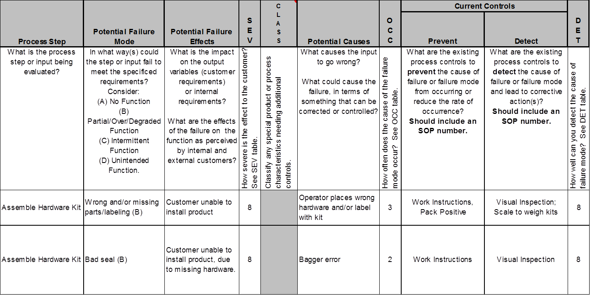
PFMEA - Step 2
Potential Failure Effects
For each Failure Mode,
determine what effect
the specific failure
could have on the
process output.
TIPS
There should be at least one failure effect for each failure mode.
Effects should be specific, clear, and leave no doubt to the uninformed reviewer.

Slide 50
Potential Effect(s) of Failure
Effect of failure mode based on what customer might notice/experience
Includes subsequent process operations
Typical effects may include, but are not limited to:
  No Function
  Partial/Over Function/Degraded over time
  Intermittent Function
  Unintended Function
  Erratic operation
Notes:
This is taken directly from the EQS manual, If you use this terminology to reference the type of failure effect you will most certainly score top marks in Q3 of the PFMEA section.
Again, brainstorm all the potential causes for one effect before moving on. You’ll save a lot of time in the Excel spreadsheet that way. As a tip, you may want to brainstorm the issues separately on Post-It’s or a flipchart first, before filling out the form. That way, you won’t miss anything.

Slide 51

PFMEA – Step 3
Class
Identify special product or process characteristics

Slide 52
PFMEA - Step 4
Potential Causes
For each Failure Mode,
determine the possible
cause of the failure.
TIP
There should be at least one potential cause for each failure mode.

Slide 53
Potential Cause(s) of Failure
“…how the failure could occur.”
Described in terms of something that can be corrected/controlled
Requires determination of root cause
Sources of process variation that cause the failure mode to occur
Typical failure causes may include, but are not limited to:
  Improper torque – over, under
  Improper weld – current, time, pressure
  Inaccurate gauging
  Improper heat treat – time, temperature
  Inadequate gating/venting
  Part missing or installed incorrectly
  Thermocouple broken
  Typographical error

Slide 54
PFMEA - Step 5
Current Controls
For each potential cause, list the current method used for preventing and/or detecting failure.
TIPS
This step in the FMEA begins to identify initial shortcomings or gaps in the current control plan.
If a procedure exists, enter the document number.
If no current control exists, list as “none.” There may not be both preventive and detection controls.

Slide 55
PFMEA - Step 6
Assign Detection
(How easily can the
cause or failure
mode be detected?)
Assign Severity
(How serious is the
effect if it fails?)
Assign Occurrence
(How likely is the cause to occur?)

Slide 56
PFMEA - Definition of Terms
Severity (of Effect) - severity of the effect on the Customer and other stakeholders (Higher Value = Higher Severity)
Occurrence (of Cause) - frequency with which a given Cause occurs and creates Failure Mode. (Higher Value = Higher Probability of Occurrence)
Detection (Capability of Current Controls) - ability of current control scheme to detect the cause before creating the failure mode and/or the failure mode before suffering the effect (Higher Value = Lower Ability to Detect)
Caution: Notice the scale difference for Detection

Slide 57
Example: Severity Rating Definitions

Slide 58
Example: Occurrence Rating Definitions

Slide 59
Example: Detection Rating Definitions

Slide 60
PFMEA - Step 7
Calculate the Risk Priority Number
RPN = Severity x Occurrence x Detection
TIPS
The RPN is used to prioritize the most critical risks
Higher RPNs are flags to take effort to reduce the calculated risk
  Continually work to improve highest risk items - don’t set an RPN threshold
In addition to RPN, examine top Severity and Occurrence risks

Slide 61
PFMEA – Remediation Guidelines
Severity – can only be improved by a design change to the product or process
Occurrence – can only be reduced by a change which removes or controls a cause. Examples are redundancy, substituting a more reliable component or function or mistake-proofing.
Detection – can be improved by deploying better controls. Examples are mistake-proofing, simplification and statistically sound monitoring.
In general, reducing the Occurrence
is preferable to improving the Detection

Slide 62
FMEA – Step 8
For the high risk items,
determine the
recommended actions.

Slide 63
FMEA – Steps 9 and 10
Resp (responsibility)
Assign a specific person
who will be responsible
for recommended actions.
Actions Taken
As actions are identified
and completed, document
in the “Actions Taken”
column.
SEV, OCC, DET, RPN
As actions are complete
reassess Severity,
Occurrence, and Detection
and recalculate RPN.

Slide 64
Summary Steps To Complete a FMEA
For each Process Input, determine the ways in which the Process Step can go wrong (these are Failure Modes)
For each Failure Mode associated with the inputs, determine Effects on the outputs
Mark special characteristics (product and process)
Identify potential Causes of each Failure Mode
List the Current Controls for each Cause
Assign Severity, Occurrence and Detection ratings after creating a ratings key appropriate for your project
Calculate RPN
Determine Recommended Actions to reduce high risks
Take appropriate Actions and Document
Recalculate RPNs
Revisit steps 7 and 8 to continually reduce risks

Slide 65
Example: “Good” PFMEA

Slide 66

Process FMEA (PFMEA)
Reviewers Checklist
  Verify risks are prioritized and high risk items have identified improvement actions
  Make sure that high risk process concerns are carried over into the control plan
  Make sure that all critical failure modes are addressed
    Safety
    Form, fit, function
    Material concerns
See PPAP Workbook for detailed PFMEA checklist

Slide 67
Progress Check: PFMEA and APQP
In which APQP phase would you first create a PFMEA?
  APQP: Phase 3 – Process Design
Which of the following activities should be done before the PFMEA?
  Purchase capital equipment
  Create the DFMEA
  Purchase End of Line Testers
  Make Tools/Molds
Which FMEA risks need recommended actions?
  All
  Any over 100 RPN
  Higher risks - by RPN, Severity or Occurrence
How would you utilize PFMEA in an ETO environment?
  By part families or by manufacturing processes
After
After
After

Slide 68
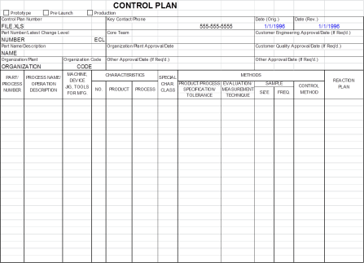
PPAP Element #7: Control Plan
What is It?
  A document that describes how to control the critical inputs (FMEA) to continue to meet customer expectations
Objective? - Planning
    Needed gaging, testing, error proofing
    Sampling and frequencies
    How to react when something fails a test or inspection
When to Use It
  Implementing a new process
  Implementing a process change
Since processes are expected to be continuously
updated and improved, the control plan
is a living document!

Slide 69
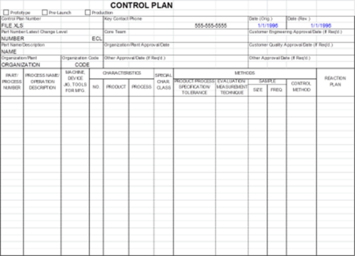
Control Plan
Tool Interaction
Process Steps
New/Revised Process Steps
Process FMEA
Process Flowchart
Risk Prioritized
Process Steps
Process Steps
Improved
Controls
New/Revised
Process Steps
Control Plan

Slide 70
The Control Plan Form

Slide 71
The Control Plan Form
Administrative Section
Identifies part number and description, supplier, required approval signatures, and dates.

Slide 72
The Control Plan Form
3 Distinct Phases
Prototype – a description of the dimensional measurements and material and performance tests that will occur during Prototype build.
Pre-Launch – a description of the dimensional measurements and material and performance tests that will occur after Prototype and before full Production.
Production – a comprehensive documentation of product/process characteristics, process controls, tests, and measurement systems that will occur during mass production

Slide 73
The Control Plan Form
Each stage of production and testing. Can be:
  Each operation indicated by the process flow
  Each workstation
  Each machine
Include testing and audits
“Process Number” should cross reference with PFMEA and Process Map

Slide 74
The Control Plan Form
Product characteristics that are important. These can be determined by referencing:
  ST Dimensions on the drawing
  Customer critical characteristics
  Process critical characteristics
There may be several for each operation
Can be dimensional, performance or visual criteria

Slide 75
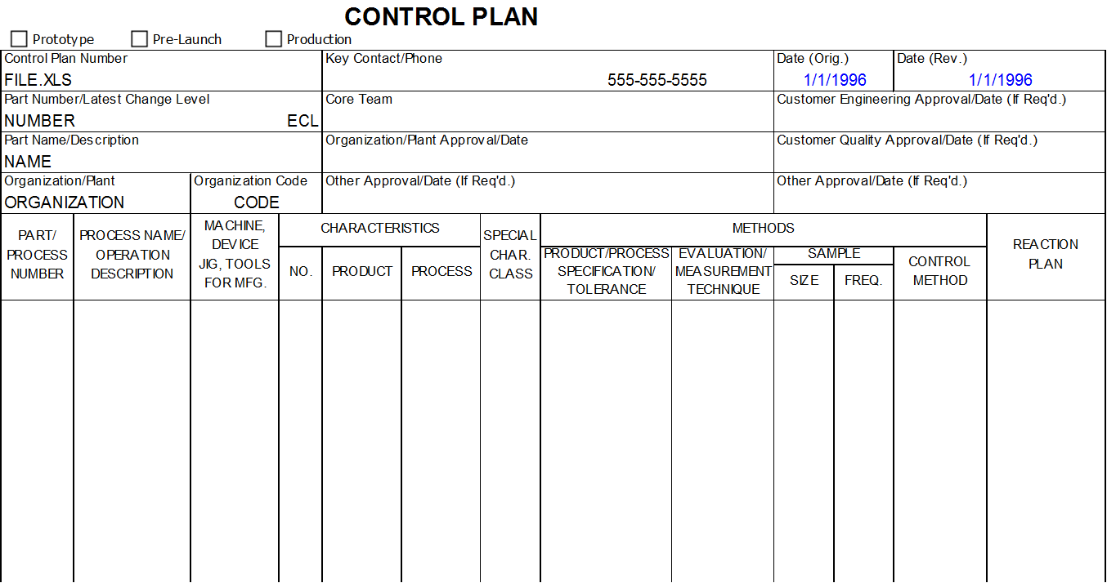
The Control Plan Form
Process parameters that are important. A process parameter is a setting made within a process that effects the variation within the operation. Examples include:
  Temperature (molding, heat treat, etc.)
  Pressure
  Fixture settings
  Speed
  Torque

Slide 76
The Control Plan Form
Class refers to special characteristics – product or process. Should align with FMEA

Slide 77
The Control Plan Form
This is a specification from the Design Record or a key process parameter

Slide 78
The Control Plan Form
How is the characteristic or parameter going to measured? Examples include:
  Caliper
  Attribute gage
  Visual
  Fixture
  Test equipment

Slide 79
The Control Plan Form
How many parts will be measured and how often. Examples:
  Final testing, visual criteria
    100%
  SPC, Audit,
    The sample size and frequency

Slide 80
The Control Plan Form
How the characteristic or parameter will be controlled (this is the record) Examples include:
  Xbar/R Chart
  NP Chart
  Pre-control Chart
  Checklist
  Log sheet
Mistake proofing
1st piece inspection
Lab report

Slide 81
The Control Plan Form
What happens when the characteristic or parameter is found to be out of control. Must include:
  Segregation of nonconforming product
  Correction method
May include (as appropriate):
  Sorting
  Rework/Repair
  Customer notification

Slide 82
Control Plan – Example
A supplier manufactures a circuit board with electronic components soldered on the board. Properly soldered connections are the major product characteristics. Two major process characteristics for the wave solder machine are solder level and flux concentration. An automated feeder controls the solder level by sensing the level of solder and feeding in additional solder as the level is reduced. This characteristic is measured 100% by checking electrically for continuity. The flux must be sampled and tested for the concentration level.

Slide 83

Control Plan: Reviewer’s Checklist
Remember the Control Plan is a planning tool –
  Use it to decide what you should be doing
  The AIAG format will help make sure the plan makes sense and is complete
Use process flow diagram and PFMEA to build the control plan; keep them aligned
Controls should be effective. Keep it simple.
Ensure that the control plan is in your document control system
Good control plans address:
  All testing requirements - dimensional, material, and performance
  All product and process characteristics at every step throughout the process
The control method should be based on an effective analysis of the process
Control plans should reference other documentation
  Specifications, tooling, etc.

Slide 84
Control Plan and APQP
In what APQP Phase would you first create a control plan?
  Prototype CP in Phase 2: Product Design
  Pre-production CP in Phase 3: Process Design
  Production CP in Phase 4: Validation
How does the reaction plan help with process design?
  Identify rework needs, quarantine product location needs, etc.

Slide 85
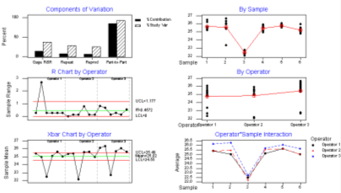
PPAP Element #8:
Measurement System Analysis (MSA)
What is It?
An MSA is a statistical tool used to determine if a measurement system is capable of precise measurement.
Objective or Purpose
To determine how much error is in the measurement due to the measurement process itself.
Quantifies the variability added by the measurement system.
Applicable to attribute data and variable data.
When to Use It
On systems measuring critical inputs and outputs prior to collecting data for analysis.
For any new or modified process in order to ensure the quality of the data.
IMPORTANT!
Who Should be Involved
Measurement System Analysis is
an analysis of the measurement
process, not an analysis of the
people!!
Everyone that measures and makes decisions about these measurements
should be involved in the MSA.

Slide 86
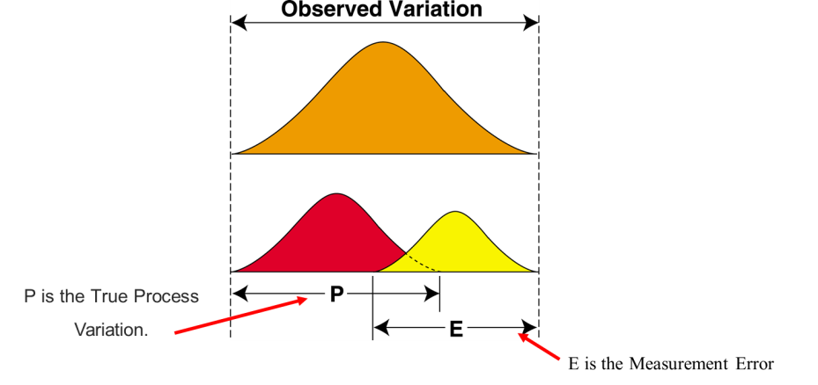
Inspection – what do you really see?
Notes:
Notes:

Slide 87
Observed Variation
Measurement System Analysis (MSA)
Resolution
Precision
(Variability)
Repeatability
Reproducibility
Measurement
System
Variation
Linearity
Observed
Variation
Accuracy
(Central Location)
Bias
Stability
Process
Variation
Calibration helps address accuracy
Notes:
Don’t explain Precision and Accuracy at this point

Slide 88


Measurement System Analysis (MSA)
Resolution
Error in Resolution
The inability to detect small changes.
Possible Cause
Wrong measurement device selected - divisions on scale not fine enough to detect changes.

Slide 89


Measurement System Analysis (MSA)
Repeatability
Error in Repeatability
The inability to get the same answer from repeated measurements made of the same item under absolutely identical conditions.
Possible Cause
Lack of standard operating procedures (SOP), lack of training, measuring system variablilty.
Equipment Variation

Slide 90
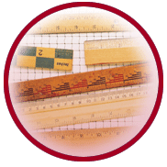

Measurement System Analysis (MSA)
Reproducibility
Error in Reproducibility
The inability to get the same answer from repeated measurements made under various conditions from different inspectors.
Possible Cause
Lack of SOP, lack of training.
Appraiser Variation

Slide 91
Variable MSA – Gage R&R Study
Gage R&R is the combined estimate of measurement system Repeatability and Reproducibility
Typically, a 3-person study is performed
  Each person randomly measures 10 marked parts per trial
  Each person can perform up to 3 trials
There are 3 key indicators
  % P/T or measurement variation compared to tolerance
  % R&R or measurement variation compared to process variation
  Number of distinct categories (ndc) or measure of resolution

Slide 92
Variable MSA – AIAG GR&R VAR(Tol)
Included in PPAP Workbook
Automatically calculates %GRR, %PV, ndc

Slide 93
Variable MSA – Gage R&R Steps
Step 1
Step 2
Step 3
Step 4
Step 5
Step 6
Step 7
Step 8
Step 9
Select 10 items that represent the full range of long-term process variation
Identify the appraisers – they should be operator who normally use the gage
If appropriate, calibrate the gage or verify that the last calibration date is valid
Open the GR&R VAR(Tol) worksheet in the AIAG Core Tools file to record data, or use MiniTab
Have each appraiser assess each part 3 times preferably in random order (Minitab can generate a random run order)
Input data into the GR&R VAR(Tol) worksheet or MiniTab
Enter the number of operators, trials, samples and specification limits
Analyze data and review GR&R and PV values
Take actions for improvement if necessary.

Slide 94

Measurements Systems Analysis MSA
Tips and Lessons Learned
Important: An MSA is an analysis of the process, not an analysis of the people. If an MSA fails, the process failed.
A Variable MSA provides more analysis capability than an Attribute MSA. For this and other reasons, always use variable data if possible.
The involvement of people is the key to success.
  Involve the people that actually work the process
  Involve the supervision
  Involve the suppliers and customers of the process
An MSA primarily addresses precision with limited accuracy information.

Slide 95
MSA: Reviewer’s Checklist
If the gage/inspection measures a special characteristic or other important feature, then conduct a Gage R&R
Make sure the study is recent - less than 1 year
Compare the control plan gages against the Gage R&Rs
% R&R and %P/T should be less than 10%
  Values greater than 10% should be reviewed with FELL
Number of distinct categories should be >5
If you question that gage, then
  Question the technique and part sampling
  Ask for additional studies

Slide 96
MSA Summary
Measurement systems must be analyzed BEFORE embarking on process improvement activities
MSA helps understand how much observed variation is from the measurement system
MSA will tell you about the repeatability, reproducibility and discrimination
Sample selection is very important – sample during normal production to capture total range of process variation
MSA assessors should be operators that would normally use the measurement system
MSA should be done on a regular basis

Slide 97
PPAP Element #9: Dimensional Results
Objective or Purpose
What is It?
To show conformance to the customer part print on dimensions and all other noted requirements
Evidence that dimensional verifications have been completed and results indicate compliance with specified requirements
When to Use It
For each unique manufacturing process (e.g., cells or production lines and all molds, patterns, or dies

Slide 98

Dimensional Results
Reviewer’s Checklist
  All design record specifications (notes, referenced specifications, etc.) shall be included in the Dimensional Results
    Material and performance specifications results can be reported on the separate Material, Performance Test Results
  Results shall include samples from each tool cavity, manufacturing line, etc.
  Data points should come from PPAP samples included with PPAP submission
    The agreed upon # of parts from the production run must be shipped to the customer for verification of form, fit, and function
    Supplier must clearly identify PPAP samples used for dimensional results
  Results that do not meet the design specification shall be addressed prior to PPAP submission
    “Not OK” results typically require changes to the manufacturing process prior to PPAP submission. In some cases the customer may agree to engineering changes.

Slide 99
PPAP Element #10: Records of Material/Performance Test Results
Material Test Results
  The supplier shall perform tests for all parts and product materials when chemical, physical, or metallurgical requirements are specified by the design record or Control Plan
  For products with FELL-developed material specifications and/or an FELL-approved supplier list, the supplier shall procure materials and/or services from suppliers on that list
Performance Test Results
  The supplier shall perform tests for all parts or product materials when performance or functional requirements are specified by the design record or Control Plan

Slide 100
Material Results
Material Results shall include:
The name of the laboratory that conducted the test
The type of test that was conducted
The number, date, and specification to which the part was tested
The actual test results

Slide 101
Performance Test Results
Performance Test Results shall include:
The name of the laboratory that conducted the test
The type of test that was conducted
A description of the test
The parameters tested
The actual test results

Slide 102
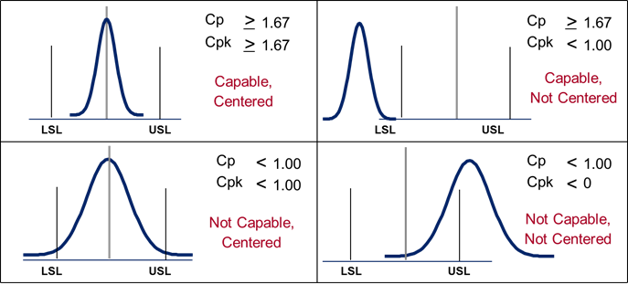
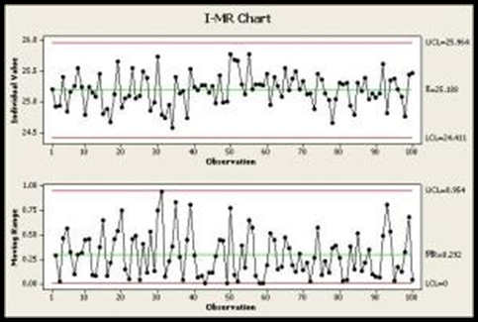
PPAP Element #11: Initial Process Studies
Capability studies are measures of how well the process is meeting the design requirements.
  Is the process employed Stable and Capable?
MSA before Cpk
  MSA must be acceptable and should represent tools/process used for Initial Process Studies
>1.67 Cpk for SCs, >1.33 for other characteristics
Cpk & Ppk minimums are higher for initial release vs. ongoing

Slide 103
PPAP Element #11: Initial Process Study
Purposes of Initial Process Study
To evaluate how well a process can produce product that meets specifications
To provide guidance about how to improve capability
  better process centering
  reduced variation
Capability studies can be used to identify a problem or to verify permanent corrective actions in the problem solving process.

Slide 104
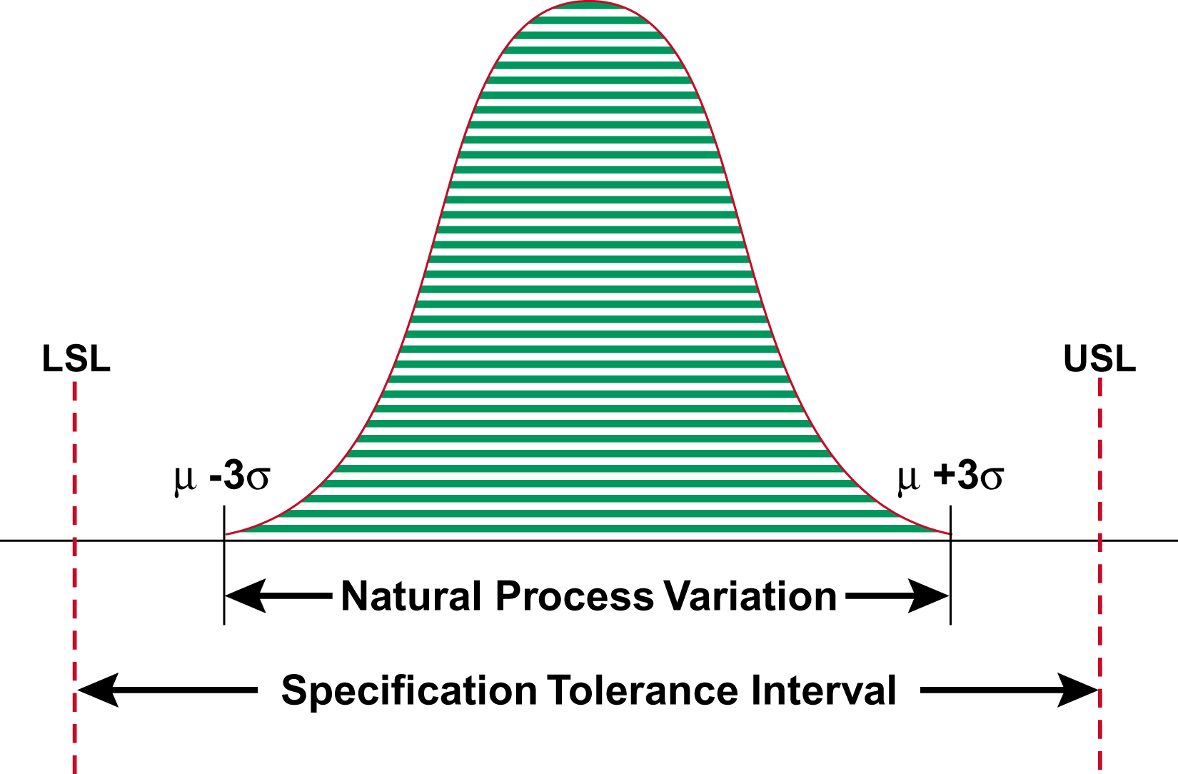
Process Capability:
The Two Voices
μ
Notes:
When we merge the natural process variation with the specification tolerance interval we have defined process capability.
And we want to have some elbow room. Over time, processes tend to shift by up to 1.5 sigma or standard deviations; so it is desirable to have some “elbow room” for the process to shift and to still remain capable.
We can control our processes—or at least use six sigma to make process improvements, but do we have control of our customer’s specs? In an ideal situation, you can establish specification limits based on your process variation. This is not always possible, however; but in FELL we have application engineers who work with our customers to establish specs. And if we can establish specs based on our products, we can often have a competitive advantage over our competitors.

Slide 105
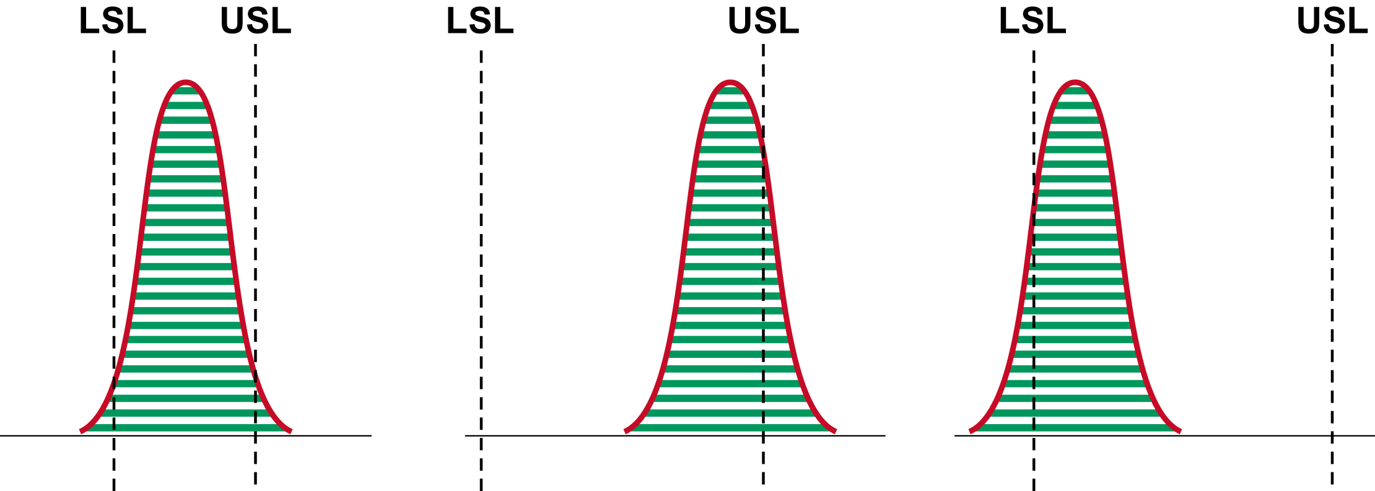
Examples of Non-Capable Processes
Product produced beyond both
Upper and Lower Spec Limits.
Product produced above the
Upper Spec Limit.
Product produced below the
Lower Spec Limit.
Notes:
Here are some examples of non-capable processes. (They ae not capable because the curves are wider that the LSL/USL.) The second and third curves are shifted to the right and left, respectively. (It would be possible to be shifted and still be capable—if the width of the curve is less than the LSL/USL—even if it is shifted.
Taguchi stressed the concept of variation reduction, driving the point home by hypothesizing that there is a cost to society as the product reaches the upper and lower spec limits.

Slide 106
Capability Studies
P
r
o
c
e
s
s
D
a
t
a
f
o
r
C
o
2
A short-term capability study covers a relative short period of time during which extraneous sources of variation have been excluded. (Guideline: 30-50 data points.)
1
5
e
1
4
U
C
L
=
1
4
.
1
8
u
l
a
1
3
V
X
=
1
2
.
6
4
l
a
u
1
2
d
i
v
i
d
n
L
C
L
=
1
1
I
1
1
.
1
0
1
0
9
0
5
0
1
0
0
1
5
0
O
b
s
e
r
v
a
t
i
o
n
N
u
m
b
e
r
P
r
o
c
e
s
s
D
a
t
a
f
o
r
C
o
2
A long-term capability study covers a longer period of time in which there is more chance for a process shift. (Guideline: 100-200 data points.)
1
5
e
1
4
U
C
L
=
1
4
.
1
8
u
l
a
1
3
V
X
=
1
2
.
6
4
l
a
u
1
2
d
i
v
i
d
n
L
C
L
=
1
1
I
1
1
.
1
0
1
0
9
0
5
0
1
0
0
1
5
0
O
b
s
e
r
v
a
t
i
o
n
N
u
m
b
e
r

Slide 107
Steps for Determining Process Capability
Step 1
Step 2
Step 3
Step 4
Step 5
Step 6
Step 7
Decide on the product or process characteristic to be assessed
Verify the specification limits
Validate the measurement system
Collect data per sample size/frequency in Control Plan
Assess data characteristics
Assess process stability
Calculate process capability
Let’s take a closer look at data characteristics and process capability
Notes:
Data characteristics – normality, distribution type, etc.

Slide 108
Step 5: Data Characteristics
Step 5
Assess data characteristics
Examine the shape of your data.
  Is it what you would expect?
  If not, investigate.
Bimodal Data
The shape of your data is important for determining which type of Capability Analysis applies. If the data exhibits a non-normal shape, consult your statistics reference.
Normal Data
Skewed Data

Slide 109
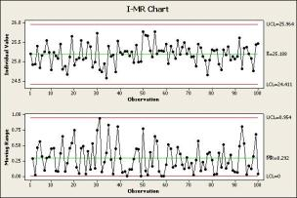
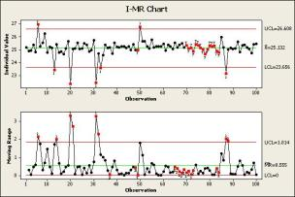
Step 6: Process Stability
Assess process stability in order to understand how your process behaves over time. Control charts are the recommended tool.
Step 6
Control Chart Examples
Process is stable and in control
Process is not stable and therefore not in control
Capability is only valid when the process being studied is stable!

Slide 110
Difference between Cp & Cpk
Cp – determines capability of producing to specification
Cpk – same as Cp, but also measures how centered the process is
It is important to look at both!
>
Cp
>
1.67
Cp
1.67
Cpk
>
Cpk
1.67
<
1.00
Capable, Centered
Capable, Not Centered
LSL
USL
LSL
USL
Cp
<
Cp
1.00
<
1.00
Cpk
<
Cpk
1.00
<
0
Not Capable, Centered
Not Capable, Not Centered
LSL
USL
LSL
USL

Slide 111
Acceptance Criteria
Acceptance criteria for critical vs. non-critical characteristics
 | Short-term | Long-term | Decision
Red (Bad) | <1.33 | <1.00
Yellow (Marginal) | 1.33-1.67 | 1.00-1.33
Green (Good) | >1.67 | >1.33
Cpk must be greater than or equal to 1.67 for critical processes
Cpk must be greater than or equal to 1.33 for non-critical processes

Slide 112
Initial Process Study: Reviewer’s Checklist
Check to see if the data demonstrates a stable process and exhibits a normal distribution
  Note: source data/ charts to understand stability may not always be provided. If you have concerns, ask for the data.
PPAPs should only be approved if the capability is greater than 1.67 for critical dimensions and greater than 1.33 for non-critical dimensions
Capability template is in the PPAP Workbook

Slide 113
PPAP Element #12:
Qualified Laboratory Documentation
Inspection and testing for PPAP shall be performed by a qualified laboratory (e.g., an accredited laboratory).
The qualified laboratory (internal or external to the supplier) shall have a laboratory scope and documentation showing that the laboratory is qualified for the type of measurements or tests conducted
  When an external laboratory is used, the supplier shall submit the test results on the laboratory letterhead or the normal laboratory report format
  The name of the laboratory that performed the tests, the date(s) of the tests, and the standards used to run the tests shall be identified.
  FELL to validate results to specifications.

Slide 114
PPAP Element #13:
Appearance Approval Report
What is It?
A report completed by the supplier containing appearance and color criteria
Objective or Purpose
To demonstrate that the part has met the appearance requirements on the design record
When to Use It
Prior to tooling for production
IMPORTANT!
Only applies for parts with color, grain,
or surface appearance requirements

Slide 115
Appearance Approval Report
Administrative Section
Identifies part number and description, supplier, required approval signatures, and dates.

Slide 116
Appearance Approval Report
Appearance Evaluation Details
Identifies supplier sourcing, texture information and submission customer signature.

Slide 117
Appearance Approval Report
Color Evaluation Details
Identifies supplier part color dimensions, use of color spectrometer or RAL charts to determine finish information
Requires supplier and customer to sign

Slide 118
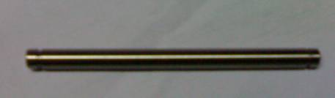
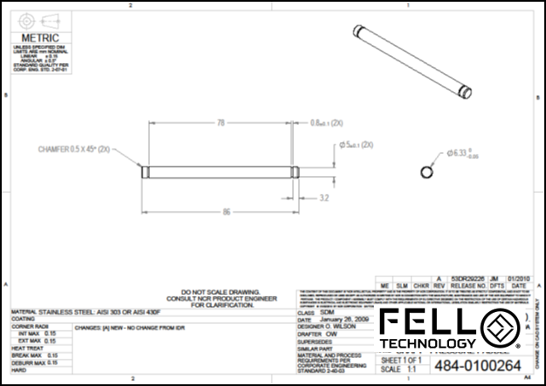
PPAP Element #14:
Sample Production Parts
What is It?
Actual samples that reflect the parts documented in the PPAP.
Objective or Purpose
Confirm cosmetic or functional part approval.
When to Use It
Sample parts should be delivered WITH the PPAP submission

Slide 119
Sample Production Parts
The sample parts provided should be the same parts measured for the dimensional results
PPAP sample quantity is based on needs from FELL Engineering, Manufacturing and Quality

Slide 120
Sample Production Parts
Sample production parts MUST be properly identified
Include the following information on the part label:
Date parts were packed
FELL part number
Quantity
Serial number
Supplier part number (optional)
Part description
Country of origin
Indication of regulatory compliance where applicable (RoHS, REACH, Conflict Minerals, etc.)
Approval markings (UL, CE, etc.) where applicable

Slide 121
PPAP Element #15: Master Samples
PPAP Element #16: Checking Aids
Master Sample (PPAP Element #15)
  The “perfect” or “golden” sample that subsequent parts can be compared against
  Often the first good part off a new tool for injection molding or stamping
  Is sometimes used to verify testing equipment and measurement systems
  Master samples are not normal for every product or manufacturing process
Checking aid (PPAP Element #16)
  Tools, gages, or test equipment, used to inspect production parts
  Examples include:
    Visual standards for color or appearance
    Shadow boards or templates used to verify general shape or presence of required features
    Custom gages

Slide 122
PPAP Element #17: FELL Requirements
APQP Kickoff - team
APQP Timeline Template
Action Item Log
Production Feasibility Agreement (PFA)
Gage Plan
Dimensional Correlation Matrix
Pass Through Characteristics (PTC)
Safe Launch Control Plan
Ramp Up & Down Plan
Packaging Specification Data Sheet
Submit Bar Code Label Packaging Approval
PPAP Interim Recovery Worksheet
Capacity R@R Worksheet
Production Readiness Review (PRR)
These items all have templates in the PPAP Workbook – many of which are self-explanatory
Items in blue have additional instructions embedded in the PPAP Workbook
Let’s take a closer look at the items in red…

Slide 123
Production Feasibility Agreement (PFA)
The PFA is designed to ensure the supplier clearly understands and can meet all FELL design requirements
It also provides a formal way to solicit and track supplier design input

Slide 124
PFA (cont.)
Supplier first reviews each specification on the print, including notes, materials and referenced specification
Supplier attaches ballooned drawing to the form

Slide 125
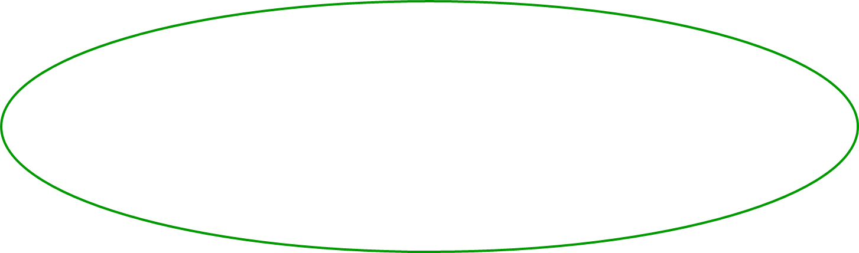
PFA (cont.)
The supplier enters design specifications and indicates capability to manufacture
For complex parts with many dimensions and features, the supplier may elect to focus on special characteristics and problem features/tolerances

Slide 126
PFA (cont.)
When requested, FELL indicates a design change to accommodate the supplier, or indicates the design must remain un-changed

Slide 127
PFA (cont.)
Supplier answers general feasibility questions and signs
Supplier may also make cost improvement recommendations

Slide 128
Gage Plan
Identify all gages to be utilized for product validation
Include any clarification or additional set up required for accurate validation

Slide 129
Gage Correlation Matrix
This template is for Suppliers to populate and compare their actual dimensions to FELL measured values
Only required for specific features as identified by FELL

Slide 130
Production Readiness Review (PRR)
Production Readiness Review (PRR) evaluates and verifies the readiness of a supplier to move from development to initial production
Utilized as an assessment of risk identification/mitigation plan, not as a pass/fail audit
Conducted prior to the manufacturing build with time to mitigate risks
Completed on-site by FELL personnel and/or by supplier as a self-assessment
Validates APQP Process was followed & checks other important factors for success

Slide 131
PPAP Element #18:
Part Submission Warrant (PSW)
What is It?
Required document in which the supplier confirms the design and validation of manufacturing processes that will produce parts to specification at a specific rate
Objective or Purpose
Used to :
  document part approval
  provide key information
  declare that the parts meet specification
When to Use It
Prior to shipping production parts

Slide 132
Part Submission Warrant (PSW)
Administrative section containing basic part information, including Part Number and Revision

Slide 133
Part Submission Warrant (PSW)
Administrative section identifying supplier location and customer location

Slide 134
Part Submission Warrant (PSW)
Here the supplier is required to identify how it has reported Substances of Concern:
IMDS, RoHS, REACH, Conflict Minerals, etc.

Slide 135
Part Submission Warrant (PSW)
The supplier indicates the reason for the PPAP submission

Slide 136
Part Submission Warrant (PSW)
The supplier indicates the PPAP level and certifies that the validation results meet all design specifications.
This certification is by cavity, production line, etc.

Slide 137
Part Submission Warrant (PSW)
The supplier declares that the PPAP submission is based on production processes run at a normal or planned production rate.
The supplier states the production rate.
The supplier indicates that any customer owned tooling is properly identified

Slide 138
Part Submission Warrant (PSW)
Prior to submitting the PPAP, the supplier representative signs the warrant, indicating the part meets FELL requirements
The customer then approves or rejects the PPAP and signs to confirm the decision
The customer approved PSW is a prerequisite for production shipments

Slide 139
Part Submission Warrant (PSW)
Reviewers Checklist
  Must be completely filled out
  Must be signed by the supplier
  P/N must match the PO
  Product family submissions allowed
  Submitted at the correct revision level
  Submitted at the correct submission level
  Specify the reason for submission
  Include IMDS, RoHS, etc. as required
  Clearly state the production rate used for validation

Slide 140
PPAP Progress Check – Final (True/False)
FELL considers FAI to be better than PPAP
FMEAs should have additional actions identified
The supplier should complete the Control Plan prior to the production trial run
The reaction plan part of Control Plan is optional
The supplier should state the production rate used during the production trial run on the PSW
T
F
T
F
T
F
T
F
T
F

Slide 141
PPAP Summary
PPAP checks that any process changes have been properly designed and validated, and the resulting process is capable of repeatedly producing parts to specification
The PPAP elements should be part of your Quality Management System. PPAP shouldn’t require much extra effort, because you’ve already done the work internally to manage your changes.
Reacting to later issues with the product or process can be expensive and time-consuming!

Slide 142


